Slide 1

Thoughts on Serving the Customers
Divide and Conquer Serve

Slide 2

Customers are Different
Even if you exclude
Background
Environment
Platform
Circumstances
Customers are different and respond positively to different interfaces depending on their current goal
Even the same person will may have a different goal on your website.

Slide 3
Non-Personas
Instead of the usual personas, which concentrate on background and context, this is about dividing the customers by user goals
Users, regardless of background, come to AMR for a reason, to book a resort
  The customers have different styles to accomplish that goal

Slide 4
Non-Personas
Customers want to book resorts
  Speeders
    I know the resort I want, get out of my way and let me book it.
      Repeat customers, travel professionals, group travelers
  Shoppers
    I have one or two criteria, and want help picking a resort for me.
      “You gotta go to Dominican Republic”, First time luxury travelers, former cruiseshippers
  Browsers
    I want a vacation. Show me what you got.
      Potential Customers, Younger, Competitor Customers

Slide 5

Speeders Ideal Interface
All other constraints aside, the Speeder wants:
Resort chosen or easily approved
  Easy room choice.
Checkout limited to a confirm button
Adverts, extras and add-ons AFTER purchase

Slide 6

Shoppers Ideal Interface
Shoppers want
Give me a handful of options based on the criteria in my head, I’ll give it a thumbs up or thumbs down, Emperor style
No special needs for checkout, just wants to believe that the chosen resort is the BEST resort for them
Adverts, extras and add-ons before purchase, but only if they are related to the main purchase, only if they enhance the vacation.

Slide 7
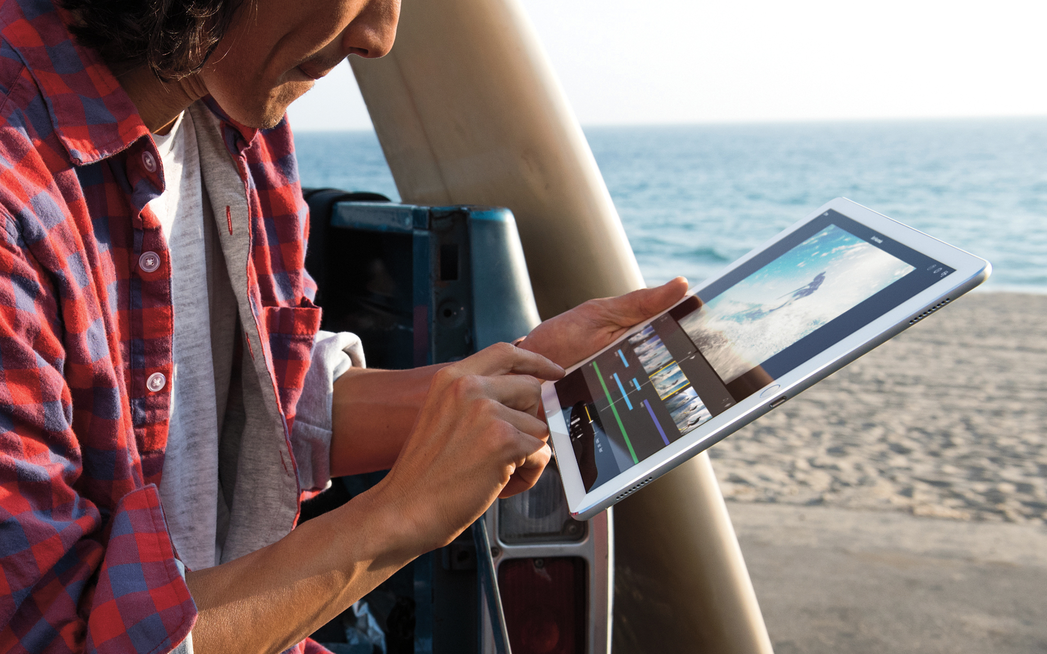
Browsers Ideal Interface
The Browser Wants
“Tell me a story”
A show, with minimal user input, with affordance to give positive/negative feedback. A “like” button.
They want to be inspired to buy
Open to adverts, extras and add-ons at any point. “Extras” may become deciding criteria.

Slide 8
How we doin’?

Slide 9
Speeders: B+
The booking widget, especially now that it is winnowing by location, works well for Speeders
A type-ahead search would help them get to their chosen resort quickly
A login and ‘repeat vacation’ option would serve them well

Slide 10
Shoppers: C
The Booking Widget is built for speed, not comparison
The content pages are built for Browsers
We offer no comparison, no recommendation
We do not offer a method for saving more than one resort
  Even our ‘save’ resort is accomplished by adding it to the cart, pretending you will buy it
  Shoppers are moving from tab to tab to compare resorts, working around the interface

Slide 11
Browsers: B
Destination Pages are their ‘story’ but still require them to
  A. Navigate from place to place
  B. Either remember or immediately select a resort
A ‘Boxcar’ link would be a simple win
  A Boxcar is a serial navigation, that would allow the user to go from Colombia > Costa Rica > Curaçao without resorting to the main nav
Even better, a ‘show me everything’ carousel with an option to save a place/resort for later would serve the Browsers.

Slide 12
A better Shopper experience
Let me see what you have and pick the best subset
Let me dismiss resorts that “aren’t me”
I will do research, but not too much
I want to believe I got the “best” resort for me

Slide 13
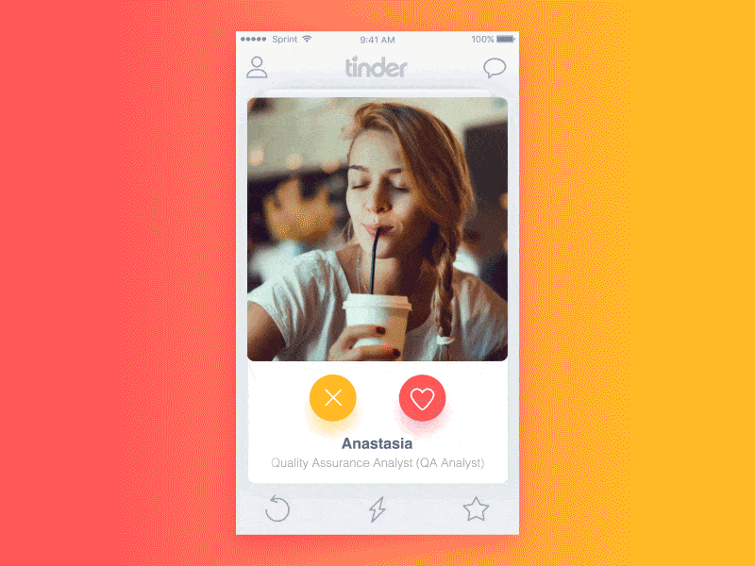
Finding a Resort is like… dating?
Primarily Visual
Small set of criteria to cut “ocean” down to manageable set
A winnowing process, often in multiple rounds, multiple sessions
It is Work– unless the interface makes it fun

Slide 14
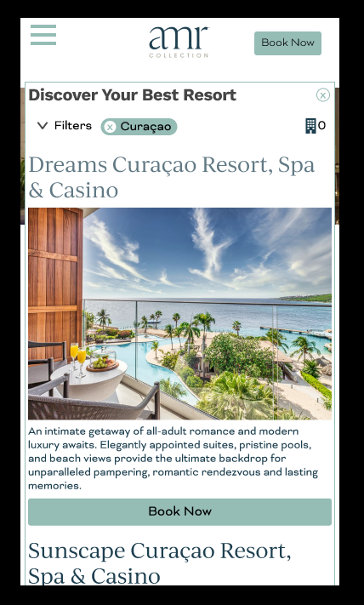
Swipe right to save resort
Primarily Visual
Used for a Brand, a Nation, or a Region, OR search results, not the whole list
  Small set of criteria to cut “ocean” down to manageable set
Multiple Rounds available, or Book Now always available
Easy and fun

Slide 15
Try it out
https://www.figma.com/proto/dEmk6IXY9D2Nozix44xg9A/AMR-Library?node-id=313%3A2341&scaling=min-zoom&page-id=0%3A1&starting-point-node-id=313%3A2341
Choose Book Now > Where > Curaçao > Explore Curaçao
    Swipe right on first resort, left on next two.
    I built this demo into the Booking Widget, but it is more appropriate in the Brand, Nation, Region pages.

Slide 16
References
Breaking down the brilliant and simple design of Tinder
  https://uxdesign.cc/breaking-down-the-brilliant-and-simple-design-of-tinder-cc4e07859c5e
Mobile Subnavigation
  https://www.nngroup.com/articles/mobile-subnavigation/
How too much choice can be a problem for online retailers
  https://www.userzoom.com/ux-library/how-too-much-choice-can-be-a-problem-for-online-retailers/

